Slide 1


Business case summary
For people with mental health problems living in residential care
Linda Sellars, Director of Quality and Change ASC, Nottingham City Council
Karla Banfield, Market and Business Partnerships, Nottingham City Council
Shaun Bennett, Project Lead, Campbell Tickell

Slide 2
Agenda
The journey so far…
The Business Case
  The Cohort
  Outcomes required
  Proposed model
  Proposed SIB structure
  Proposed financial modelling
Question and Answer

Slide 3
The Cohort
A total cohort of 36 people with mental health problems comprising:
  A named cohort of approx. 30 who are currently placed in high cost residential placement
  An unnamed cohort of approx. 6 who are in acute hospital

Slide 4
The Outcomes Required
Move the individuals into suitable long term independent accommodation in the community
Enable the individuals to sustain their accommodation in the community
Improve the well-being of individuals who move into independent accommodation

Slide 5
Proposed Model for the Intervention
A wrap around progression service comprising:
Support workers with expertise in mental health and preparing for independent living
Mental health specialist input
A housing partner or brokerage function
Four stages are proposed to the intervention which are: assessment; preparation; the move; sustainment
Moving the individuals only once as most are already living in long-term accommodation (i.e. the care home)

Slide 6
Summary of the Model

Slide 7
The Intervention Team
Indicative Team (inc. ‘in-house clinical input’) | FTE
Project Manager | 1
Case co-ordinators | 1
Case co-ordinator – Council employee seconded | 1
Transition and sustainment support workers | 2
Behavioural analyst | 1
OT | 0.5
Clinical Psychologist | 0.25
The SIB team will need to ‘ramp up’ gradually
The Commissioned Service will be based on the personal budgets of those who move.
Care and support (based on personal budget) | 37 FTE staff

Slide 8
Stage 1 - Assessment
Reassessment of needs on behalf of the Council
Best Interest assessment on behalf of the Council
DOLS assessment on behalf of the Council, where appropriate
The Council will be the ‘decision maker’
Development of support plan baseline using 24/7 model
Complete the Council’s paperwork with the Council logging the assessment on its own system

Slide 9
Stage 2 - Preparation
Preparation for the move while the person is still living in residential care, including support with recovery and independence
As the person is living in a private residential care home the SIB provider will need work closely with the owner and obtain their co-operation
Specialist mental health input is included as part of the intervention model when required
Preparation will involve mapping out a staged approach to moving the cohort

Slide 10
Stage 3 – Arranging the Move
Sourcing long term accommodation by either working with a housing partner or directly (i.e. if a housing association).
Securing accommodation that can provide shared night care where required e.g. core and cluster or a single site with a number of self contained flats
Making arrangements for the move including transport, furniture, white goods, liaison with utilities etc.
Liaison with landlord over signing up tenancy and payment of rent

Slide 11
Stage 4 - Sustainment
Providing specialist mental health input where required as part of the SIB
Making available an existing emergency respite 24/7 bed where there is a relapse
Brokering access to mainstream services so that the individuals can access them by the time the SIB ends
Providing advice, support and training to the commissioned care and support team on sustainment and independent living (e.g. self-care, managing their environment, money management including rent payments)

Slide 12
Housing Partner
Role of the housing partner is to source longer term accommodation – probably a housing association to claim high rates of Housing Benefit
Leasing accommodation from the Private Rented Sector (PRS) on a long term basis to prevent landlords from terminating Assured Short-hold tenancies
Purchasing existing properties using private finance and repaying loans using higher rates of HB for supported living
Accessing housing through choice based letting scheme
Building housing by entering into an agreement with developers (e.g. L&G) that construct modular housing off site and charging Local Housing Allowance

Slide 13
Proposed Outcome Metrics

Slide 14
Proposed Structure for the SIB

Slide 15
Financial Modelling: Assumptions
The SIB outcomes can be delivered within 2 years
4 drop out before first primary outcome and another 5 drop out before second primary outcome
Day to day care and support based on average of existing support independent living packages for high medium and low those under 44
Day to day care and support rate of £17 per hour
Costs of interventions for support and specialist staff based on costs for similar interventions elsewhere
 | Q1 | Q2 | Q3 | Q4
High (16) | Mobilisation | Preparation
Medium (12) | Mobilisation | Preparation |  | Move
Low (8) | Mobilisation | Preparation | Move

Slide 16
Summary of Financial Base Case Modelling
 | 2019/20 | 2020/21 |  | 2021/22
 | Y1 | Y2 | SIB total | Y3 - indicative
Outcome Payments | 104,099 | 718,411 | 822,509 | 0
LCF Contribution to Outcome | (20,820) | (143,682) | (164,502) | 0
Baseline - transition at old care rates | 2,139,559 | 0 | 2,139,559 | 0
New Ongoing Care Costs | 138,954 | 1,037,761 | 1,176,715 | 830,297
Scheme drop out at old care rates | 152,600 | 610,648 | 763,248 | 681,706
Net costs | 2,514,392 | 2,223,137 | 4,737,529 | 1,512,003
Current Costs - 30 to be moved from care homes | 2,188,412 | 2,188,412 | 4,376,824 | 2,188,412
Cost avoidance - 6 to be diverted from care homes | 410,363 | 410,363 | 820,725 | 410,363
Total Current cost | 2,598,775 | 2,598,775 | 5,197,550 | 2,598,775
Saving / (Pressure) | 84,383 | 375,638 | 460,021 | 1,086,772

Slide 17
SIB Costs
Breakdown of SIB costs
Outcome Payments
Analysis of Outcome payments:
Intervention costs total | 660,333
SIB SPV costs | 66,250
Evaluation costs | 35,000
Return for social investor | 60,927
 | 822,509
Total cohort of 36 | % of total | Outcome cohort | £ per outcome | Total Outcome payment £
Primary Outcome 1: move into stable accommodation | 22.50% | 32 | 5,783 | 185,065
Primary Outcome 2: sustain stable accom' for 12mths | 67.50% | 27 | 20,563 | 555,194
Secondary Outcome: improvements in well being | 10.00% | 27 | 3,046 | 82,251
 | 100.00% |  |  | 822,509

Slide 18
Business Case Issues
Provider market
Capacity to deliver the SIB – could split into 2 lots but may fragment
Do the mental health providers have an enabling ethos?
Financial issues
During the intervention there are estimated savings of £442K
After the intervention there are estimated recurring savings of £1m per annum
LCF contribution of 20% of the outcome payments
The financial model shows base case as the break-even position for the SIB. The social investor may require a lower success rate for their own break even position.

Slide 19
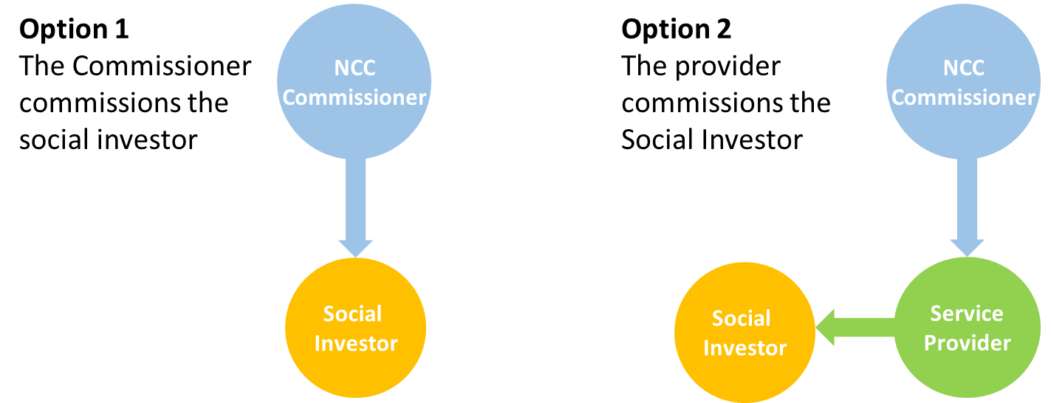
Value for money
The intervention costs of £18,343 per person have been benchmarked with a similar intervention of £20,193 pp.
Cost per week of £1,388 before the intervention and £807 after.
Procurement
Procure the SIB and the Day to Day support from the same provider. Use of the framework agreement for the day to day support
Council needs to consider options for commissioning the social investor

Slide 20


