Slide 1
Focus on Homelessness
Planning our Help: Stakeholder Workshop
20th July 2017

Slide 2
Agenda
9:45am | Recap – scene setting, pressures and work underway
9:55am | Workshop 1: Preventing Homelessness
10:30am | BREAK
10:45am | Workshop 2: Responding to Homelessness
11:30am | Workshop 3: Recovering Settled Accommodation
12:10pm | Councillor Jane Urquhart, NCC
12:15pm | Next steps and close

Slide 3
Why are we here?

Slide 4
Social Inclusion (Homelessness) Strategic Commissioning Review
Purpose – to develop recommendations for how services will be funded, planned and delivered in the future
Account for changes (need / demand, legislation, funding pressures, innovations) and ensure resources are being put to best use
Wider context – how the City works to respond to homelessness

Slide 5
Homelessness in all its forms is on the rise across the country
  statutory acceptances are up 44% (09/10 to 15/16)
  placements in temporary accommodation are up 52% (10/11 to 15/16)
  use of bed and breakfast is up 250% since 2009
  rough sleeping is up 132% since 2010
Source: Crisis

Slide 6
Causes?
  Welfare reforms, economic trends and rising housing costs (freeze on LHA, benefit cap, Universal Credit, scrapping housing allowance for u21s) – squeezed incomes for poorest
  Reduced availability of social housing (1% rent reduction, Right to Buy) and more households accommodated in less secure private rented sector
  Loss of preventative support – austerity and end of Supporting People (LA cuts of 67% since 2010)
Notes:
Nottingham is in the bottom 10 local authority areas for disposable income per head (ONS) – more at risk from squeezes or shocks to income
23,078 households are in receipt of full or partial housing benefit
Concerns re roll out of Universal Credit
Younger population – i. more at risk of deprivation ii. affected by scrapping of housing payments to 18-21 year olds

Slide 7
What do we need to respond to?
Rough sleeping – up from less than 5 in 2010 to 35 in 2016 (CLG returns)

Slide 8
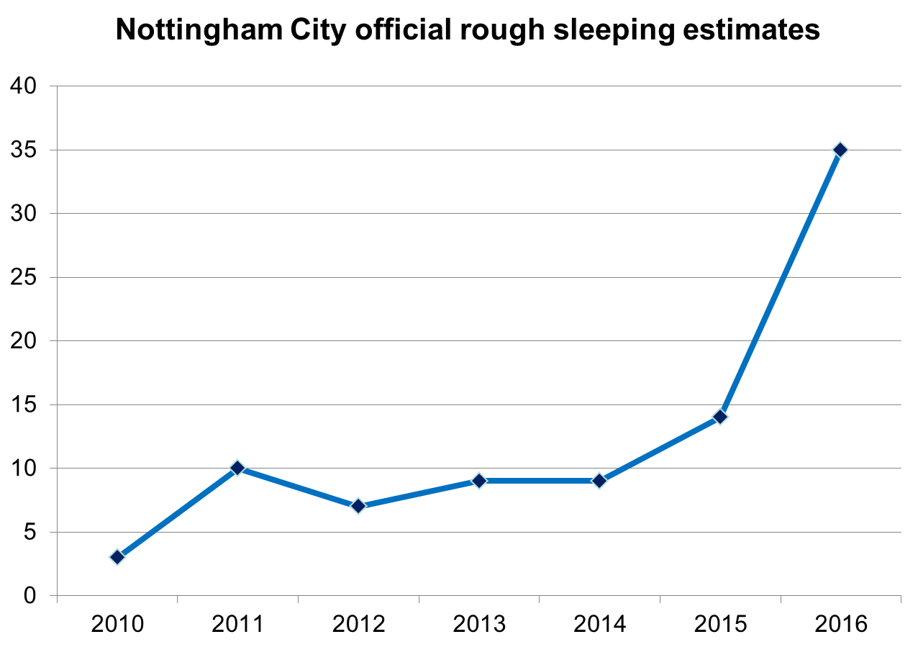
Notes:
This chart shows Nottingham City’s official rough sleeping estimates submitted to CLG from 2010-2016. The figures are from a snapshot conducted on a single night in autumn each year.
Benchmarking is difficult as the methodology utilised by different authorities and permitted by CLG varies widely. Nottingham’s methodology is comparatively robust as it is based on an actual count of rough sleepers conducted by the NCC commissioned Street Outreach Team, whereas other authorities rely on estimates only. Nonetheless the national estimate for the number of rough sleepers on a given night increased by 134% between 2009/10 and 2015/16.
Approximately 1/3 of people rough sleeping are local to Nottingham (i.e. they have a local connection); around 1/3 are EU migrants or people without recourse to public funds (i.e. failed asylum seekers); and around 1/3 are people from elsewhere in the UK without a local connection to the City. Efforts are made to reconnect people not from the City back to their local authority area or their home country.

Slide 9
What does our plan need to respond to?
Rough sleeping – fewer than 5 per night in 2010 to 35 in 2016 (CLG returns)
  Risks to people sleeping rough
  Commitments to No Second Night Out
  Unbudgeted spend of £100k in 16/17 on support during winter

Slide 10
What do we need to respond to?
Rough sleeping – fewer than 5 per night in 2010 to 35 in 2016 (CLG returns)
  Risks to people sleeping rough
  Commitments to No Second Night Out
  Unbudgeted spend of £100k in 16/17 on support during winter
  Bed and breakfast – 117 households (May 2017)

Slide 11
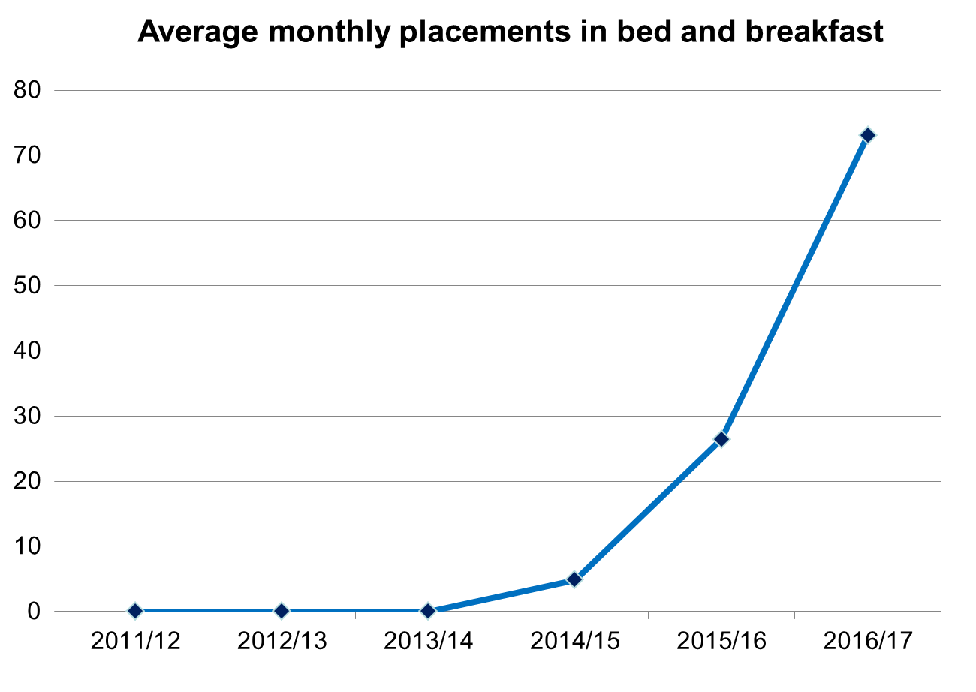
Notes:
B&B used to meet statutory duty to provide temporary accommodation when no spaces are available in supported accommodation services. We’ve had to rely on B&B more and more because hostels / supported accommodation is full

Slide 12
Notes:
This graph shows us total placements in B&B each year over the past three financial years (blue columns) and the average cost per placement in each year (red). Not only are we seeing the number of households placed into B&B, we are also seeing the cost per placement is increasing – most likely because households placed into B&B are now having to stay there for longer.

Slide 13
What does our plan need to respond to?
Rough sleeping – fewer than 5 per night in 2010 to 35 in 2016 (CLG returns)
  Risks to people sleeping rough
  Commitments to No Second Night Out
  100k in 16/17 on support during winter
  Bed and breakfast – 117 households (May 2017)

Slide 14
What does our plan need to respond to?
Rough sleeping – fewer than 5 per night in 2010 to 35 in 2016 (CLG returns)
  Risks to people sleeping rough
  Commitments to No Second Night Out
  100k in 16/17 on support during winter
  Bed and breakfast – 117 households (May 2017)
  Mostly families
  Suitability of response (environment, support, duration of stay, location)
  Serious and unbudgeted expenditure

Slide 15
What do we need to respond to?
Funding pressures / challenges
  Current HRS spend of c£4.3m pa – savings of £445k pa needed from 2018/19
  Risks associated with other losses of funding (e.g. preventative support, VCS, etc)
  Uncertainties through proposed changes to funding of supported housing (devolved HB ‘top ups’)

Slide 16
What do we need to respond to?
Funding pressures / challenges
  Current HRS spend of c£4.3m pa – savings of £445k pa needed from 2018/19
  Risks associated with other losses of funding (e.g. preventative support, VCS, etc)
  Uncertainties through proposed changes to funding of supported housing (devolved HB ‘top ups’)
Mental ill health
  High proportion of people with mental health needs amongst homeless in City
  Mental health support ‘not meeting needs’

Slide 17
What do we need to respond to?
Access to / stability of settled housing

Slide 18
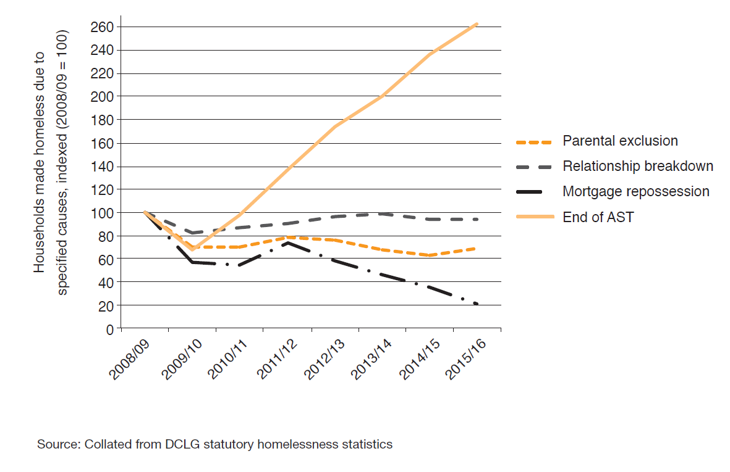
Homelessness caused by tenancy breakdown (national)
(assured shorthold tenancy)

Slide 19
What do we need to respond to?
Access to / stability of settled housing
  Significant increase in breakdown of tenancies as cause of homelessness
  Increased reliance on less secure PRS to resolve homelessness
Further demand pressures
  Welfare Reform, roll out of Universal Credit

Slide 20
What do we need to respond to?
Homelessness Reduction Act
  Duty to provide advisory services – specifically to meet the needs of certain groups
  Duty to work with all households to prevent homelessness within 56 days
  Duty to prepare a plan of action for prevention
  Duty to help to relieve homeless for all households for 56 days
  Expected to come into force in 2018
  Extra funding (two years only) for new burdens

Slide 21
What do we need to respond to?
Rough Sleeping
Access to settled homes
Reactive B&B use and spend
Mental health needs
Lack of security in PRS
H’less Reduction Act
Supported accom funding changes
Funding pressures & £445k pa HRS saving
Welfare reforms & other drivers of need

Slide 22
What do we need to respond to?
Rough Sleeping
Access to settled homes
Reactive B&B use and spend
Mental health needs
Lack of security in PRS
H’less Reduction Act
Supported accom funding changes
Funding pressures & £445k pa HRS saving
Welfare reforms & other drivers of need

Slide 23

Process
Notes:
We’re working towards detailed plans, but today is about hearing some feedback on some of the options available to us. We’ll take on board feedback to help shape up our final approach to planning and funding homelessness services.

Slide 24
Workshops
Mix of people in room – let’s hear all feedback
3 areas – prevention, response, sustainment
Listen to us talk about the things we’re focusing on and the ideas for how we might respond
Highlight benefits and pitfalls of different ideas put forward & shape / propose alternatives
Help us to put forward the best approaches to respond to the issues we face

Slide 25
Workshop 1: Prevention

Slide 26
Prevention
Nancy Cordy – Commissioning Manager

Slide 27
“Prevention is key”
Last year ILS services (services that provide advice to help people to avoid homelessness) worked with 2,125 different households.
In high demand – services have waiting lists BUT feedback that support wasn’t available for long enough.
Homelessness prevention service | Crisis service | Service for families
1,281 | 432 | 412
6-9 months | 4 weeks | 2 weeks – 12 months

Slide 28
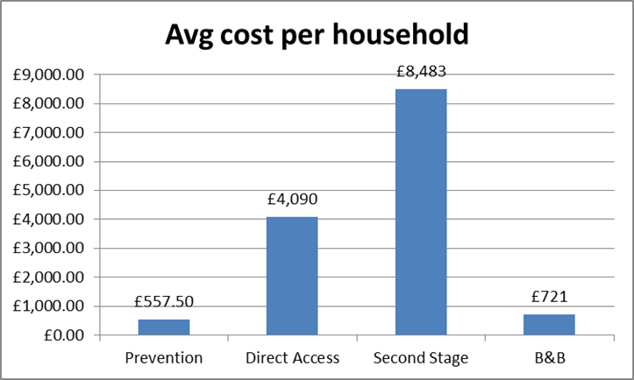
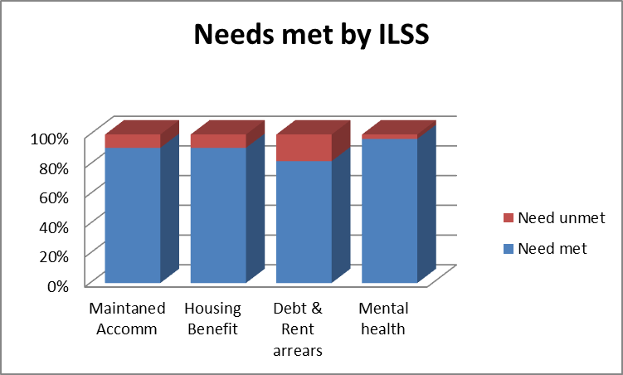
“Prevention is far more effective than cure”
Strong stakeholder support for prevention:
It costs us less
It’s more successful at meeting peoples needs
Notes:
Direct access and second stage are types of temporary accommodation provided once someone has lost their previous accommodation.
The graph on the left shows that prevention costs far less per household worked with than providing temporary accommodation. There are some differences in the people who might use these services / the extent of their needs, but the main message is that prevention costs less.
The graph on the right shows that most identified needs are met by ILSS (preventative) services

Slide 29
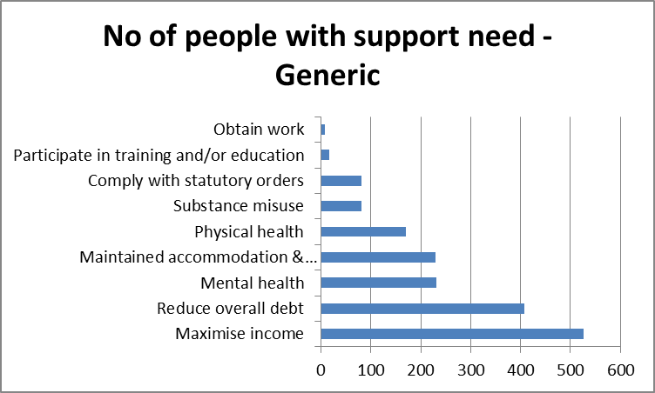
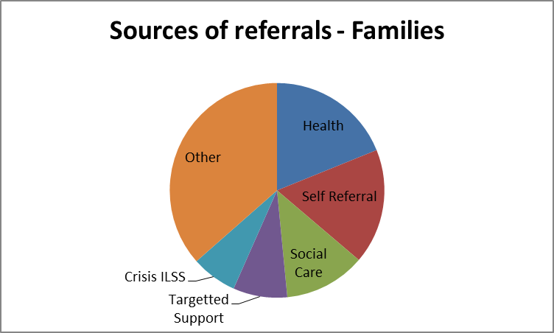
“Too many people miss out on support from services”
People told us:
Criteria were too restrictive
Thresholds were too high
BUT with limited resources do we need to be more targeted?

Slide 30
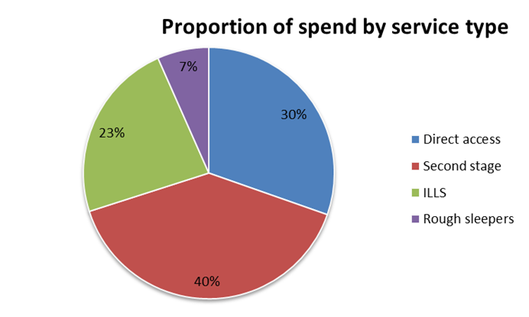
“Spend to save”
Currently almost 25% of the HRS homelessness budget is spent on preventative services.
Q) Do we need to shift this and how?
Notes:
HRS – Housing Related Support funding for homelessness

Slide 31
“The Homelessness Reduction Act should help to improve the prevention of homelessness”
Aim: More prevention activity which has more chance of working
  Free info & advice for all
  Duty to refer
  Definition of “threatened with homelessness” – 56 days from 28 days
  Assessment & Personalised Housing Plan

Slide 32
“Anyone can end up homeless”
  Young People – care leavers
  Mental Health
  People leaving hospital
  People released from prison
  Victims of domestic abuse
  NRPF
  Survivors of modern slavery
  Priority Families

Slide 33
“Encourage services to work closer together”
The risks:
“Pushed from pillar to post”
Duplication
Missed opportunities to identify early indicators
The options:
Identified pathways
Co-location
Co-ordination
Joint assessments

Slide 34
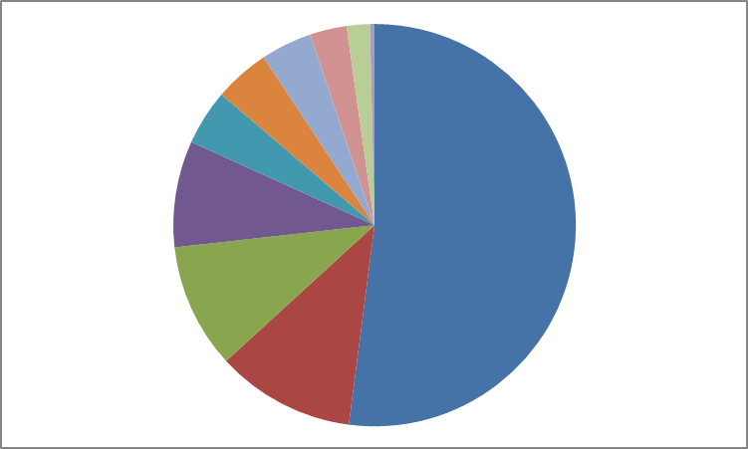
“Early intervention by housing advice services”
993 citizens support
£64,487.40 claimed in benefits
£97,712 in debt addressed
217 citizens avoided homelessness
Private tenants

Slide 35
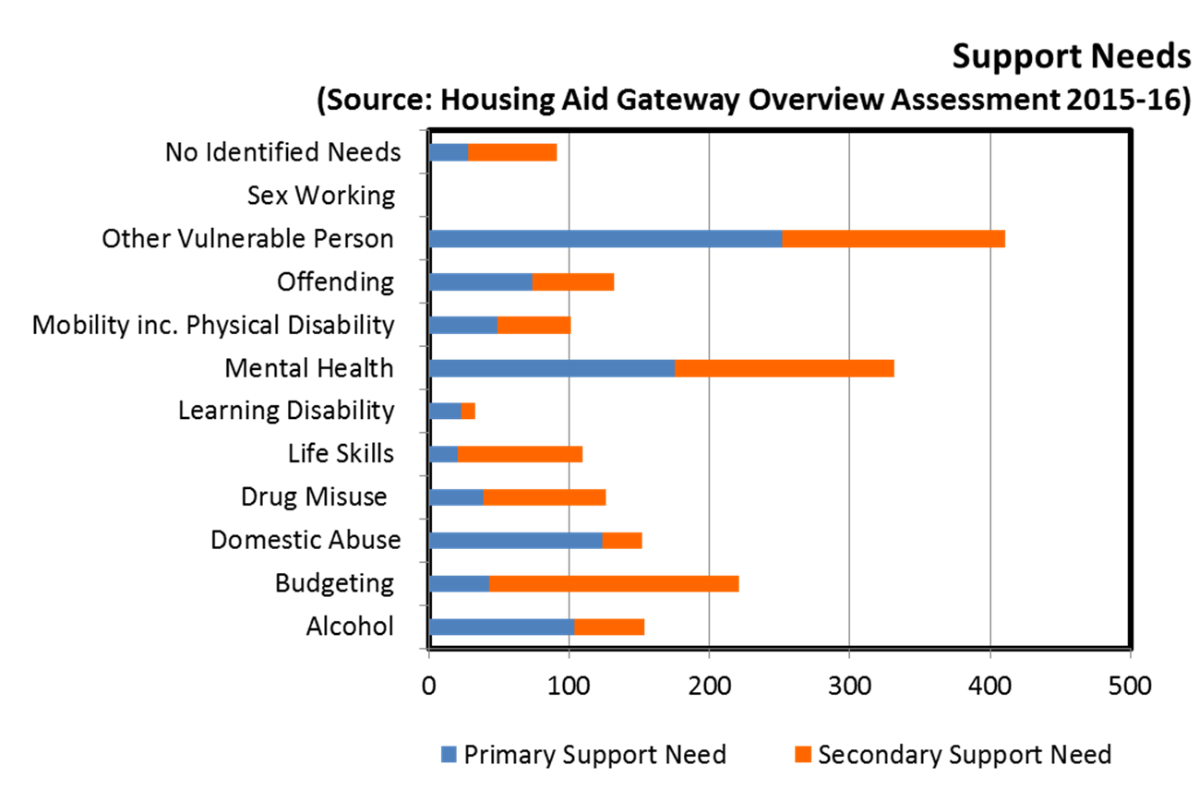
“We need to get to the root”

Slide 36
“Families struggle to manage on the little that they have”
“Government welfare policy is the main reason people are at risk of homelessness”
“Universal credit is a big problem”
Option:
Co-ordinated and targeted approach to preparing people for Universal Credit – what does this look like?

Slide 37
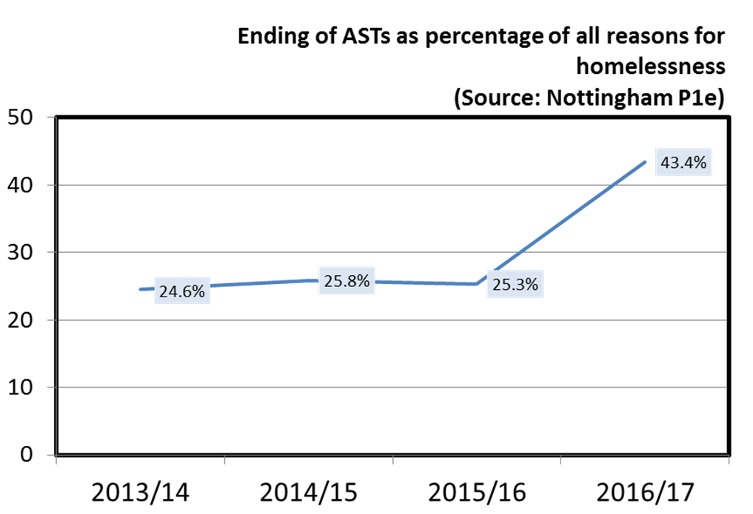
“People in the private rented sector are vulnerable”

Slide 38
“PRS gives no stability to people”
  Accessibility
  Affordability
  Quality
  Stability
  Option:
  Replicating the support tenants in social housing can access for those in the PRS.
Notes:
PRS – Private Rented Sector

Slide 39
Options - prevention
  Protect spending on prevention
  Improve the way services work together
  Focus preventative activity around individual plans for prevention developed at Housing Aid (required for anyone at risk within 56 days under the new Homelessness Reduction Act) – tighten focus on tenancy sustainment
  Focus on homeless families – particularly those:
    In the private rented sector
    Affected by Universal Credit

Slide 40
Questions
  Which ideas should we carry forward, and which need a rethink?
  What do we need to keep in mind in developing the ideas you support?
  Have we focused on the right areas? What’s missing?
  You have around 25 minutes

Slide 41
Break – 15 mins

Slide 42
Workshop 2: Responding to Homelessness

Slide 43
What’s covered?
Assistance for people who have no accommodation available – no opportunity for prevention
Includes assistance for singles and families
Access to accommodation with or without support
Assistance for rough sleepers

Slide 44
Rough sleeping
Rough Sleepers Enablement Service (SOT)
£215k pa
No Second Night Out (NSNO)
£50k pa
Winter Shelter
(not funded)
Winter Measures
£100k in 16/17
Funding in 17/18 TBC

Slide 45
Rough sleeping – findings
Increase in number of people found sleeping rough from fewer than 5 to 35 from 2010-16
Local connection
Less than 40% from Nottingham City
Major issues in supporting people without recourse to public funds (refugees and migrants) – approx 15%
Similarly challenges in supporting people without local connection – approx 25% from Nottinghamshire
Reconnections happening (50 in 16/17) but on voluntary basis only

Slide 46
Rough sleeping – findings (cont’d)
Those with local connection have complex needs – exclusion, substance misuse – not just about housing
Overlap with begging relatively small (15%) but may be a cause
Support for outreach activity in the City in feedback – ”one of the best”
Challenges in access to supported accommodation
Support for winter shelter / measures – 193 individuals accommodated, 116 positive outcomes (6,000 spaces used) – “winter shelter is invaluable”

Slide 47
Rough sleeping – options / proposals
Tender for further delivery of outreach support for rough sleepers – maintain services
Commission / contract for winter measures on a longer term basis – but maintain diversity
Create opportunity for person centred housing and support solutions through commissioning of supported accommodation
Seek to develop wider partnership strategy for rough sleeping to include enforcement and substance misuse treatment

Slide 48
Accommodation and support
Singles
Total of 10 supported accommodation services (for homelessness) commissioned in the City with HRS funding providing 334 beds per night
  Direct access – 129 beds
  Specialist ‘2nd stage’ – 205 beds

Slide 49
Overview of services - Direct access
Total bed spaces: 129
HRS spending on Direct Access: £1.2m
Homelessness Prevention Gateway
London Road
55 beds
Single Adults
GH House
15 beds
Single Adults
Pelham Avenue
10 beds
Single Adults
New Albion
24 beds
Single Adults
40 Forest Road W
15 beds
Single Adults

Slide 50
Overview of services - Second stage
Total bed spaces: 205
HRS spending on second stage: £1.6m
Corporation Oaks
12 beds
Young people
Ozanam House
13 bed
Young people - Female only
Young People’s Accommodation Service
41 beds
Men’s Complex Needs
23 beds
Male only
Colville Complex Needs
23 beds
Female only
Bentinck Road and MV House
38 beds
Drug & Alcohol
Offenders’ Accommodation
55 beds

Slide 51
Accommodation and support
Singles
Total of 10 supported accommodation services (for homelessness) commissioned in the City with HRS funding providing 334 beds per night
  Direct access – 129 beds
  Specialist ‘2nd stage’ – 205 beds

Slide 52
Accommodation and support
Singles
Total of 10 supported accommodation services (for homelessness) commissioned in the City with HRS funding providing 334 beds per night
  Direct access – 129 beds
  Specialist ‘2nd stage’ – 205 beds
Also non-commissioned temporary accommodation (e.g. YMCA)

Slide 53
Accommodation and support
Singles
Total of 10 supported accommodation services (for homelessness) commissioned in the City with HRS funding providing 334 beds per night
  Direct access – 129 beds
  Specialist ‘2nd stage’ – 205 beds
Also non-commissioned temporary accommodation (e.g. YMCA)
Families
Two non-commissioned services for homeless families providing a total of 77 units – Enhanced Housing Benefit

Slide 54
Accommodation and support – findings
Majority of households in B&B are homeless families (currently 77%) – P1E
Lower support needs
Support need | % with need
Physical or sensory disability | 8.6%
Mental health | 7.0%
Drug or alcohol problem | 6.3%
Offenders or at risk | 4.7%
Mobility | 3.9%
Risk of domestic violence | 3.9%
Learning disability | 2.3%

Slide 55
Accommodation and support – findings
Throughput in all supported accommodation has slowed significantly, creating fewer vacancies:
  1/3 fewer families and 1/4 fewer singles moved through in 2016/17 compared with 2014/15
  Average length of stay has increased from 21 to 29 weeks for families and 13 to 16 weeks for singles
  Particular issues in accessing specialist services
  An issue of supply? PRS less accessible and desirable – difficulties in resettlement

Slide 56
Accommodation and support – findings
Throughput in all supported accommodation has slowed significantly, creating fewer vacancies:
  1/3 fewer families and 1/4 fewer singles moved through in 2016/17 compared with 2014/15
  Average length of stay has increased from 21 to 29 weeks for families and 13 to 16 weeks for singles
  Particular issues in accessing specialist services
  An issue of supply? PRS less accessible and desirable – difficulties in resettlement
Increased presence of CICs in the City (over 100 beds) – filling gap? Low / no regulation and some concerns over local connection

Slide 57
Accommodation and support – findings
Low success rates in single homeless services – 35% leaving to positive outcomes and high repeated use – “hamster wheel” – though note complexity of issues
Environment in larger supported accommodation projects raised as an issue by stakeholders / people using services “too many people using drugs” – risks to users
‘Bad’ referrals linked to demand pressures – “any available space”
Finding “the right” support worker

Slide 58
Proposals – Private Sector Leasing Scheme
“..better co-ordination of PRS is needed”
“use of direct access.. as a method of discharging temporary accommodation duty.. removing units [for people with support needs]”
Opportunities to divert for those with lower needs (solution to B&B)?
Approach:
Negotiate to take on lease of PRS properties – guarantee income for period at preferable rate
Properties available for LA nominations and sub-let to homeless households

Slide 59
Proposals – Private Sector Leasing Scheme (cont’d)
Advantages
Relatively quick to introduce – increase capacity fast
Significant cost savings over B&B use
Prevents long stay in B&B accommodation and associated risks to citizens / legal challenges
Means of improving standards in PRS
In addition, continue work to increase ‘dispersed tenancies’ for families

Slide 60
Options / proposals – supported accommodation contracts
Longer term contract for stability and investment
Look to increase capacity (beds) through tender
Freedoms over accommodation to be used through less prescriptive contracts (outcomes focused) – but seek shift to improved model
Look for services to bolster Enhanced Housing Benefit to manage reduction in HRS – saving needed
Create space for Housing First style approach for clients who will benefit

Slide 61
Options / proposals – supported accommodation contracts (cont’d)
Look to build on feedback from citizens re what matters to them – relationships, motivated support workers, environment (linked to PIE principles)
Explore specific citizen-led requirements to build into specifications

Slide 62
Mental health

Slide 63
Mental health
Dr Ben Pattison, Centre for Regional Economic and Social Research, Sheffield Hallam University

Slide 64

Overview of research
Purpose:
  Exploratory research study that seeks to understand the mental health needs of homeless people in the city of Nottingham
Commissioned by NHS Nottingham City Clinical Commissioning Group
Research includes:
  survey and in-depth interviews with homeless people
  stakeholder interviews
  secondary data analysis
  good practice review
Survey complete - draft interim findings have been presented to steering group
Final findings next year

Slide 65
About the survey
167 people completed the survey (target: 150)
All had recent experience of homelessness (currently or in the past 6 months)
Surveyed between February and May 2017
Accessed through general homelessness services (not mental health):
  homelessness hostels, night shelters, day centres, refuges, Housing Aid, temporary supported housing schemes, street outreach workers
Efforts were made to ensure the sample included a range of ages, ethnicities, and that women were adequately represented
Half (52%) had been homeless for longer than one year

Slide 66
Key findings
Three-quarters (74%) had been diagnosed with a mental health issue at some point
  Depression (61%) and anxiety were most common but high levels of other issues - e.g. schizophrenia/bipolar disorder (15%) and PTSD (15%)
Two-thirds (62%) had current, self-reported mental health issues
One in five (19%) had been detained under the Mental Health Act (sectioned)
  one-quarter still homeless following discharge (small sample)
Over half (59%) with mental ill health were accessing support/treatment.
  A further 19% reported that they did not need any support or treatment
  Medication was the most common form of treatment

Slide 67
Reflections
Mutually reinforcing relationship between mental health and homelessness - sometimes mediated by other issues such as drug or alcohol use
Majority of respondents (84%) report that their mental health or wellbeing had been negatively affected by their homelessness
No evidence of a large cohort unknown to mental health services (i.e. most are diagnosed)
  BUT, diagnosis may not reflect clients view of their mental health and they may not be receiving the appropriate services
Complex needs - high levels of experience of:
  Prison, domestic violence, alcohol/drug dependency, local authority care
More detail on causation and individual experiences emerging from in-depth interviews

Slide 68
Mental health
MH pathway review found supported accommodation working well for those able to access it
Working with social care and health colleagues to understand wider system

Slide 69
Mental health
MH pathway review found supported accommodation working well for those able to access it
Working with social care and health colleagues to understand wider system
Options
Strengthen MH pathway – seek to increase capacity within MH specific services
Create more support for MH within general homelessness services
Seek co-location to build scope for further join up
Focus on accommodation and seek access via ASC

Slide 70
Your views – workshop
Which ideas should we carry forward, and which need a rethink?
What do we need to keep in mind in taking forward the ideas you support?
Have we focused on the right areas? What’s missing?
You have around 35 minutes
Please write it down!

Slide 71
Recap – overview of proposals
Rough sleeping – continue winter shelter / support, engage partners on causes e.g. substance misuse and seek flexible options through supported accommodation (Housing First)
Seek to establish Private Rented Sector Leasing Scheme to quickly increase access to accommodation (for lower needs / families) – PRS properties sub-let by the Council or partner social landlord to homeless households
Long term, freer (wider and outcomes focused) contracts for supported accommodation – more opportunity to use all available accommodation to increase available beds and to provide for different needs
Savings needed from spend on supported accommodation – encourage use of Enhanced Housing Benefit where eligible for funding

Slide 72
Workshop 3: Recovering Settled Accommodation

Slide 73
Recovering from homelessness:
Supply of settled accommodation
Rachael Harding, Housing Strategy Specialist

Slide 74
Homelessness prevention and relief
Recovery from homelessness

Slide 75


Length of stay in TA has increased
Move on is achieved for less than a quarter of people in supported accommodation
Why?
People can’t find…or access decent accommodation that they want…or can afford…

Slide 76
Local Housing Profile

Slide 77
Why are there difficulties?
Pressure on Housing supply
Difficulties in availability and accessibility for both PRS and Social Housing
Affordability issues in the PRS which could extend to social housing for under 35s and those affected by Benefit Cap
Both tenures are suitable for habitation – however, there can be issues with property standards in the PRS
Social housing remains more desirable than the PRS

Slide 78

Impact of Government policy on supply
National Housing Policy
Welfare Policy
Other
Future funding model of supported housing

Slide 79
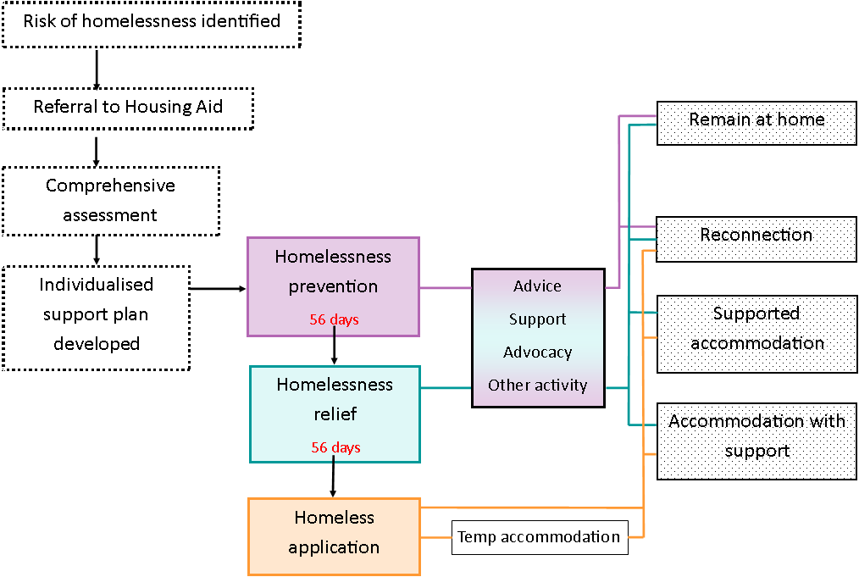
New system of delivery
Homelessness Reduction Act

Slide 80

Addressing accessibility of traditional tenure options
Social housing
Allocations policy, managing expectations, roles of housing associations, new builds, shared housing
Private rented sector
Enhancements to PRS access schemes

Slide 81

New housing delivery models
Housing First (principles – utilising EHB)
Social letting agency – for long term housing (seamless transference of temp to perm without household moving)
Utilising micro homes
Role for Social enterprises and Community Interest Companies
WHAT ELSE…?

Slide 82


Support
What support do people need for positive and sustained resettlement?
Who should deliver the support and in what way?
Support is needed
It shouldn’t be time-limited
There shouldn’t be a delay in receiving it,
It should be aligned with pre-tenancy training,
There should be a multi-agency approach to delivery

Slide 83

Specific areas of focus
- Enhanced pathways
Young people
Mental health
People leaving hospital
People released from prison
NRPF
Survivors of modern slavery
Priority families

Slide 84
Recovering from Homelessness
– Your views
Which ideas should we carry forward, and which need a rethink?
What do we need to keep in mind in developing the ideas you support?
Have we focused on the right areas? What’s missing?
You have around 35 minutes
Please write it down!
Enhanced Private Rented Sector Access Scheme
Housing First
Micro homes etc.
Resettlement sustainment support
Managing expectations
Allocations policy
Social Letting Agency
Social Enterprises and Community Interest Companies
Notes:
• Enhanced Private Rented Sector Access Scheme
Consider connecting the existing NPRAS to other teams working with PRS tenants and landlords (i.e. Safer Housing/housing benefits/welfare rights/housing advice/DASH) to provide a more comprehensive PRS tenant and landlord support service. Possible enhancements could include: building better relationships with landlords; early advice hotline; dispute resolution; mutual exchange options; matching services; tenancy training; promotion of good tenant behaviour; introduction of landlord liaison officers
• Housing First
Principles of building support around the tenant once they are stabilised in accommodation. Usually most workable for complex / multiple needs people. However, could we also develop a flexible model and utilise Enhanced Housing Benefit for the coordination of support more generally in new tenancies?
• Micro homes etc.
Low cost, purpose built portable temporary accommodation units that can be located on development sights with sundries whilst they await planning permission for works to begin. Preferable to B&B because are lower cost and are self-contained / self-catered. How could they be utilised as a stepping stone to longer term accommodation?
• Resettlement sustainment support
Option to review the functionality of the resettlement aspect of ILSS. How to link to the personalised housing plans that will be developed under the new Homelessness Reduction Act duty? Should this service take on a coordination function of multi-agency support in a similar approach to the CAF? Could we link in community navigator volunteers to fulfil ‘handholding’ aspects of support. Do we want to see mandatory links to employment support / tenancy training?
• Managing expectations
NCC to provide clear information on housing options – realities and expectations, that is then utilised by all commissioned and other services to ensure that people are getting accurate messages about the availability of housing and housing pathways in Nottingham. What is needed to make people engage with this?
• Allocations policy
Proposals have already been put forward and agreed regarding the way social housing will be allocated to homeless households. The practicalities of implementing immediate changes are being worked through which will see CBL removed from Band one applicants and one offer of accommodation made. A more comprehensive review of the policy will be completed over the next year to align it with new requirements from the Homelessness Reduction Act. Consideration will need to be given to the categorisation of priority groups.
• Social Letting Agency
The council (or an agent managing housing on their behalf like an ALMO) sublets accommodation from a PRS landlord, guaranteeing them an agreed rent for the term of a lease but then the council allocates it and manages the tenancy in the same way they would their own stock. The social letting agency would work alongside a private sector leasing scheme and allow for the transference of temporary accommodation to permanent accommodation without requiring a physical move to a different property for the household.
A SLA could also open up the potential for the introduction of social landlord managed shared accommodation which arguably is needed to help mitigate against some of the restrictions that out of work people aged under 35 will face. What are people’s views?
• Social Enterprises and Community Interest Companies
Should we encourage more social enterprise – e.g. housing associations teaming up with social enterprise organisations to provide housing at the same time as skill building / creating employment opportunities? Is there a role for CICs in this? What is the future for them in the new funding landscape – is this an opportunity for them to show what they can contribute and work collaboratively alongside registered providers and charities?

Slide 85
Councillor Jane Urquhart, Portfolio Holder for Planning and Housing, Nottingham City Council

Slide 86
Next steps
Planning Workshop
(July 2017)
Developing and selecting ideas
Finalise & commission services
(Approval Sept / Oct 2017)
New arrangements commence
(from April 2018)
Prepare draft plan and consult with wider stakeholders
Notes:
Provisional timescales – the aim is to have new arrangements (i.e. new contracts / services) in place by April 2018. This means that we’ll be taking our plans along for our councillors to consider around September this year. We’ll share some worked up proposals for further feedback before then.

Slide 87
Contact:
Bobby Lowen, Commissioning Lead
Nottingham City Council
alan.lowen@nottinghamcity.gov.uk
0115 876 3571

