Slide 1
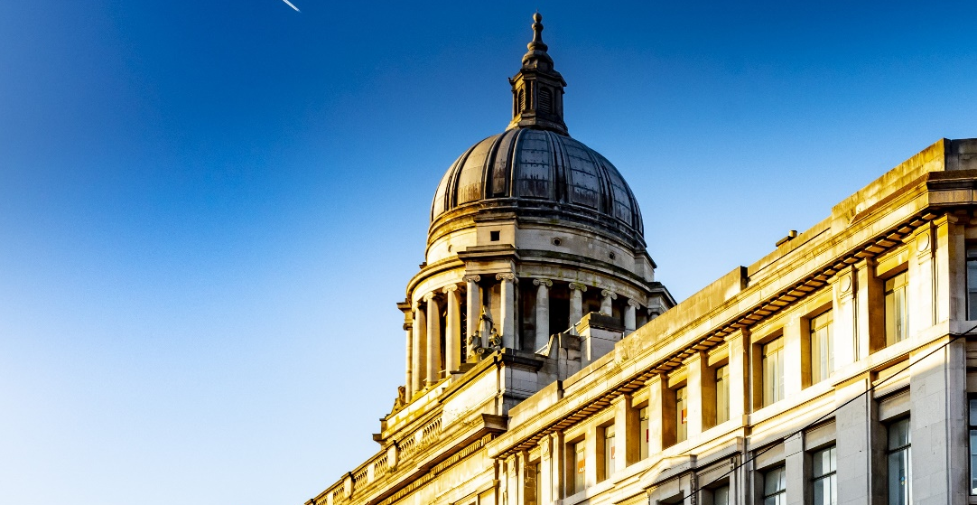
Nottingham City Council
Budget Consultation 2025/26

Slide 2
Our budget for 2025/26
This year’s budget is about getting our house in order and putting the Council on a sustainable financial footing.
There are 20 proposals, totalling £17.91m next year and £24.19m over four years.
We are consulting the public on six initial savings proposals totalling £10.78m next year (£16.10m over four years).

Slide 3
Our budget for 2025/26
There are a further 14 proposals totalling £7.12m in the first year (and £8.09m over the next four years).
These proposals have been deemed not for public consultation because they are about internal processes.
Further details on the budget including the level of Council Tax will follow early next year.

Slide 4
Our vision
A renewed council that delivers for local people and leads Nottingham forward.
A council that gets the basics right and delivers the best local services we can afford.
A council that is ambitious for the future and helps our city reaches its full potential.

Slide 5
Our pledge
We will use our resources better to meet people's needs more effectively.
We will work with our citizens and our partners to make sure the council is the best it can be.
We have been honest about the financial challenges we have faced, and we will continue to be open with you.

Slide 6
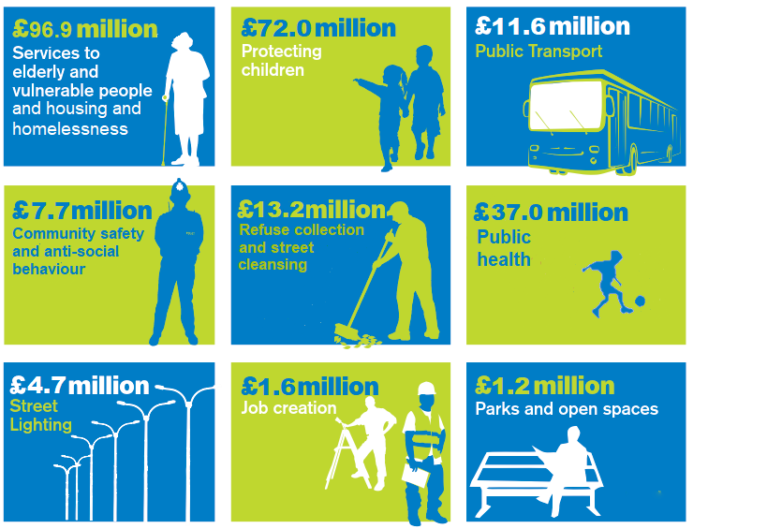
How we spend our money
The Council spends around £245 million of its annual revenue on services.

Slide 7
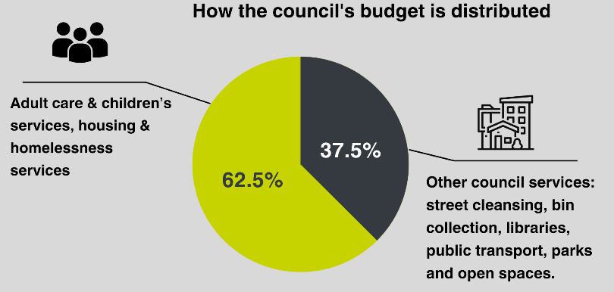
Pressures we face
The demand for vital services in Nottingham has never been greater while, like all households, we must also deal with rising costs.
We spend nearly two-thirds our budget looking after older people, protecting children and helping people who are homeless.

Slide 8
Budget proposals for consultation
Effective management of vacant posts through an initiative to manage vacancies more prudently.
Proposed saving = £4.928 million in 2025/26
Reduce costs and improve efficiency by streamlining layers of management and team sizes.
Proposed saving = £4.009 million in 2025/26
Improve productivity and manage staffing budgets by reducing sickness rates and enhancing performance management.
Proposed saving = £1.222 million in 2025/26

Slide 9
Budget proposals for consultation
Introduce commercial expertise to reduce third-party spending and improve procurement processes
Proposed saving = £500,000 in 2025/26
Conduct a council-wide IT review to rationalise applications, systems, licenses, and subscriptions, ensuring business continuity and cost savings.
Proposed saving = £100,000 in 2025/6
Improving digital access through development of the website and digital forms, shifting demand to more efficient service delivery.
Proposed saving = £29,000 in 2025/26

Slide 10
Next steps
The budget consultation takes place from 17th December until 13th January. Have your say at:
www.nottinghamcity.gov.uk/engage-nottingham-hub
The draft Budget and Medium-Term Financial Plan will be considered by the council’s Executive Board in January and February 2025
Final approval at the Full Council meeting on 3 March 2025

Slide 11
Engagement events
Public engagement event
19th December 5.30pm – 6.30pm at the Council House
Voluntary & Community sector organisations
8th January 12:30pm to 1:30pm. Hybrid on MS Teams & at Loxley House
Businesses & Partners event
8th January - 2pm until 3pm. Online on MS Teams
Public engagement event
8th January - 6pm until 7pm. Online on MS Teams
Disability Involvement Group & deaf and hearing-impaired citizens
9th January - 3pm until 4pm. Hybrid on MS Teams & at Loxley House
Joining instructions and links on the budget survey webpage

Slide 12
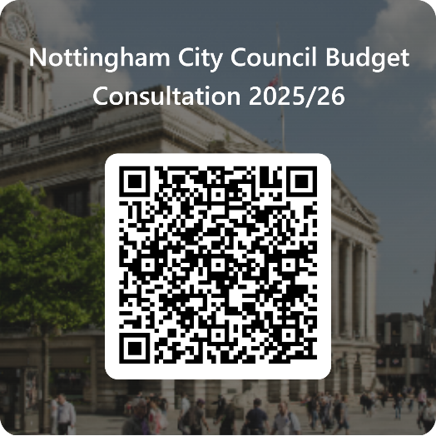
www.nottinghamcity.gov.uk/engage-nottingham-hub/open-consultations/202526-budget-savings-proposals/

Slide 13
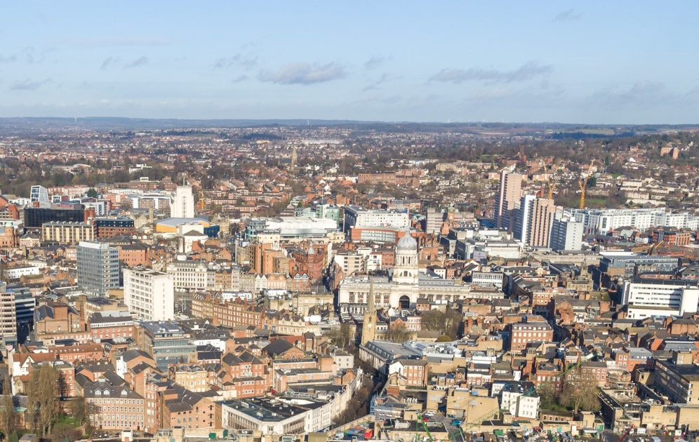
Questions

