Slide 1
Welcome This meeting is being recorded PLEASE PUT YOUR MICROPHONE ON MUTE Early Years Business Meeting 22nd February 2024 10am, 1.30pm and 6pm Microsoft Teams
Kathryn Bouchlaghem: Head of Service, Early Years
Katherine Crossley: Early Years Project Officer
Cheryl McLean: Early Years Funding Co-ordinator
Catherine Smith: Early Years Programmes Manager
Caroline Vissani: Senior EYFS Teaching and Learning Specialist

Slide 2
Update from Nick Lee, Director of Education

Slide 3
Aims of the Business Meeting
Share hourly rates for early years entitlements for coming year
Share changes of new statutory guidance on Provider Agreement 2024/25
Importance of contributing to Childcare Sufficiency Assessment data – place planning, impact on individual businesses
The Child’s Journey – funding and quality

Slide 4
Funding Consultation
National requirement to consult on local funding formulae required when:
Proposed change to existing formula, or;
A new formula is needed
DfE’s ‘Easy Explainer’ outlined:
How LA’s national hourly rates are determined
Maximum of 5% can be retained by the LA
Remaining 95% passported out to the Sector

Slide 5
Funding Consultation Feedback
Question | Response
Should we have different hourly rates for the different early years entitlements? | 82% agreed
Should we redirect the flexibility supplement to the hourly base rate funding available? | 91% agreed
Should we have a 3 & 4 year old base rate with deprivation supplement for EYPP children? | 91% agreed
Should we establish two separate base rates for the two different 2 year old entitlements, with a higher rate for disadvantaged 2’s? | 82% agreed
Should we have a 9 months plus base rate with no supplements from September 2024? | 82% agreed
Should we extend the existing SEN Inclusion Fund criteria down to all children accessing early years entitlements? | 97% agreed

Slide 6
Provider Agreement - Key Changes
Updated to reflect new operational Statutory Guidance for LA’s
Use of ‘early years entitlement places’ not ‘free’ places in P.A.
New sections on new cohorts of children
Updated rates for 2024/25 for all early years entitlement places
End of Term Debt
Updated ‘Further Information and Example Documentation Pack’
Provider Agreement will be emailed to all providers.
Return via email only by Wednesday 6th March 2024 to enable payments to be made from 1st April 2024 onwards
Computer typed signatures are valid if sent from the registered email address

Slide 7
Early Years Funding 2024/25
 | From 1st April 2024
9 Months – 2 Year Olds (from September 2024) | £10.76 per hour (new rate)
Disadvantaged 2 Year Old Base Rate | £8.31 per hour (increase of £2.65 on April 2023 rate)
Working Parent of 2 Year Old Base Rate | £7.63 per hour (new rate)
3 & 4 Year Old Base Rate (Universal & Extended Hours) | £5.16 per hour (increase of 20p on April 2023 rate)
Deprivation Supplement | £1.00 per hour for up to 30 hours per child per week (equivalent) for 3 & 4 year olds attracting EYPP
Early Years Pupil Premium (EYPP) Supplement | £0.68 (increase of 6p on April 2023) per hour, up to 15 hours per child for children across all age groups, accessing the Early Years Entitlements
Disability Access Fund (DAF) | Increased to £910 (increase of £82 on April 2023 rate) per eligible child. Any child claiming DLA.

Slide 8
Funding Examples
Example of a 15 hour place on a 3 & 4 year old base rate;
Basic Hourly Rate without EYPP or Deprivation Supplement = £2,941.20 p/a (equivalent of £5.16 p/h)
Basic Hourly Rate with EYPP & Deprivation Supplement = £3,898.80 p/a
(equivalent of £6.84 p/h)

Slide 9
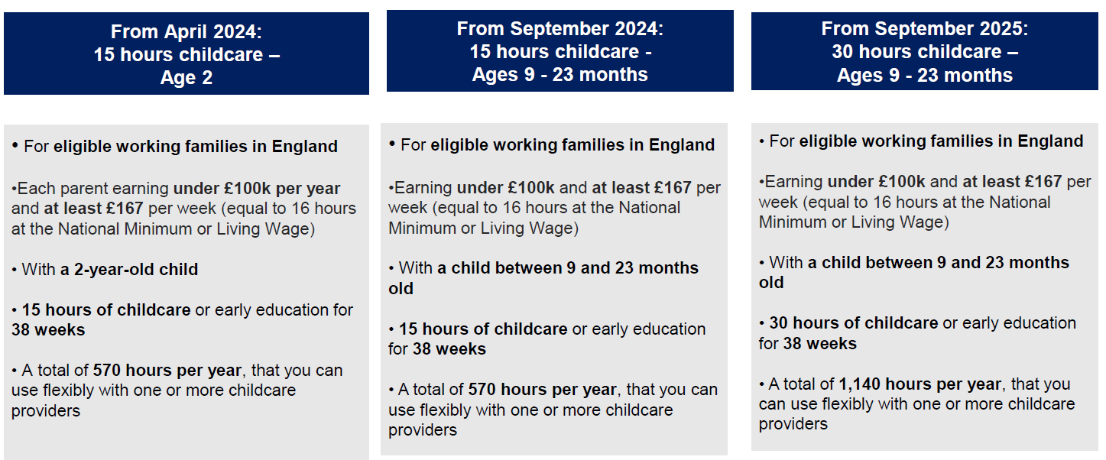
Early Years Entitlements Expansion
Form to receive an additional estimate payment for the Summer Term for working parents of 2 year olds Due back 3rd April 2024
New to funding training
Refresher training
Latest information on the Early Years Entitlements Expansion

Slide 10
Childcare Sufficiency
Full Childcare Sufficiency Assessment (CSA)
Published 2023
Sufficient childcare across all ages
Basis for sufficiency review for new cohorts of early years entitlements children (Sept 2024 & Sept 2025) and wrap-around expansion
Deep Dive Analysis
Priority Wards
Place Expansion
Capital Funding Opportunities
‘OUR ASK’ - CSA Data Refresh
Spring Term 2024 Provider Survey

Slide 11
Early Years Foundation Stage Profile (EYFSP)
 | 2022 | 2023 | Difference
GLD -Nottingham | 60.3 | 63.3 | +3.0
GLD - National | 65.2 | 67.2 | +2.0
GAP | 4.9 | 3.9 | +1.0
Good Level of Development (GLD) children achieving the expected level in all prime areas plus literacy and number

Slide 12
Early Years Foundation Stage Profile (EYFSP)
Highest Areas | Lowest Areas
Gross Motor 90.6% Building Relationships 85.9% Managing Self 84.5% Creating with Materials 83.1% Being Imaginative & Expressive 82.5% The Natural World 78.3% | Listening and Attention 79.4% Speaking 78.1% Word reading 69.4% Writing 65.0% Number 72.7% Numerical Patterns 72.1%
GLD by Gender
Girls 71.0% achieved GLD
Boys 56.1% achieved GLD

Slide 13
Training Offer linked to EYFSP Data
Pre School and F1 Agreement Trialling Physical Development Communication and Language | Tuesday 5th March | Castle Cavendish | 9:00 -12:00 Or 13:00- 16:00 | Free
Pre School and F1 Agreement Trialling Physical Development Communication and Language | Wednesday 6th March | Online via Teams | 9:00 -11:30 Or 13:00- 15:30 | Free
Developing Early Number Sense 3-4 Years | Wednesday 24th April | Castle Cavendish | 9:15-12:15 | £45
To Be Two | Pt1 Tuesday 30th April Pt2 Thursday 16th May | Castle Cavendish | 9:30-12:30 | £50
Making Interactions Count 0-2 Years | Wednesday 1st May | Castle Cavendish | 9:30-12:30 | £45
Making Interactions Count 3-5 Years | Monday 20th May | Castle Cavendish | 9:30-12:30 | £45
Book Here

Slide 14
Thank you for joining us
earlyyears@nottinghamcity.gov.uk
https://www.nottinghamcity.gov.uk/earlyyears/

